Slide 1
Email Spam Filter

Slide 2
By Abdelrahman Ahmed Shaker 20-01531 Karim Yasser Gaber 20-00062 Mohamed Ehab Sayed 20-00286 Youssef Ashraf shawky 20-00627 Mohamed Ahmed Farghaly 19-01215 Nada Rafek Nabeh 20-01539 Merna Sayed Hussein 20-00626
Under the supervision of :
Dr / Mayar Ali TA / Abdelrahman Sayed Younis .

Slide 3
Agenda
Introduction
Methodology
Reference
What is Spam
Dataset
Research Objective
Result
Problem Statement
Overview
Literature Review
Tools and Technologies
Need to extend
Future work
Proposed Approach
Conclusion

Slide 4
About this template
Introduction
In the age of modern digital communication, spam emails have become an increasing problem faced by individuals and organizations alike. With the increase in the volume of these messages and the development of sending technologies, it has become more necessary than ever to find effective solutions to combat this phenomenon.
This study aims to design and develop an effective system for filtering e-mail from spam. The project aims to provide a mechanism to identify spam messages and prevent them from reaching the user's inbox, which contributes to improving the quality of the email use experience and increasing work efficiency.

Slide 5
Introduction
Email filtering relies on a variety of details, including content analysis, message categorization, and attracting industry knowledge to both regular and unusual email journalists. This data is based on completely new data available, including shadow options and strategic messaging data.
Implementing an email filtering system can be effective in improving email usage, reducing inconvenience due to spam, and managing users while interacting with email.
The aim of this is to maximize the importance of filtering e-mail from spam, and thus to search for effective solutions to this problem in the world of electronic communication.

Slide 6
About this template
What is Spam
Spam refers to unsolicited and often irrelevant or inappropriate messages sent over the internet, typically via email. These messages are usually sent in bulk to a large number of recipients without their consent. Spam can include advertisements, phishing attempts, scams, and other unwanted content. The primary goal of spam is often to promote products or services, gather personal information, or spread malware. Email providers and filters work to identify and block spam to protect users from unwanted and potentially harmful content.

Slide 7
About this template
Research objective
Achieving high accuracy:
Using advanced machine learning techniques such as deep neural networks, random forests, and support vector machines (SVM) to achieve high accuracy in classifying email between regular messages and spam.
Reducing false positives and false negatives:
Optimize the model to reduce the number of regular messages that are classified as spam (false positives) and spam that go undetected (false negatives).
Performance efficiency:
Ensure that the email filter operates very efficiently, without significantly impacting system resources, such as memory and processing.

Slide 8
Research objective
Adapting to changes:
Develop a system capable of adapting to evolving spam tactics over time, through continuous learning and updating of the database used.
Easy to use user interface:
Design a user interface that enables users to easily manage filtered messages, such as reviewing spam messages, and placing spam messages in the white or blacklist.
Data analysis and fingerprinting:
Use data analysis and fingerprinting techniques to identify common patterns and traits in spam to improve filter accuracy.

Slide 9
Research objective
Integrating multiple technologies:
Integrate multiple spam filtering technologies, such as content-based filtering, rules-based filtering, and machine learning, for a comprehensive, integrated system.
security and privacy:
Ensure that data used in training and operation is protected, users' privacy is preserved, and that no sensitive data is shared with third parties.
Scalability:
Design the system to be scalable, so that it can handle large amounts of email without affecting performance.

Slide 10
About this template
Problem Statement
The increasing sophistication of email spammers and the evolving landscape of malicious tactics pose a significant challenge to existing email filters. Current spam detection systems often struggle with a high rate of false positives, inadvertently flagging legitimate emails as spam, or false negatives, allowing spam to infiltrate users' inboxes.
the static nature of some filters makes them vulnerable to emerging spamming techniques that exploit vulnerabilities. The lack of user-friendly customization options further hampers the adaptability of filters to individual preferences. Addressing these issues is crucial to providing users with a secure and efficient email communication environment.

Slide 11
Problem Statement
High False Positive Rate:
Legitimate emails are sometimes mistakenly marked as spam, causing users to miss important communications.
High False Negative Rate:
Some spam emails manage to bypass filters and reach the user's inbox, compromising security and productivity.
Evolving Tactics:
Spammers continuously adapt their tactics to evade detection, making it difficult for static filtering systems to keep up.

Slide 12
Problem Statement
User Experience:
Inefficient spam filtering can lead to user frustration and decreased productivity as they spend more time managing their inbox.
Scalability Issues:
As the volume of emails increases, maintaining the performance and accuracy of spam filters becomes more challenging.

Slide 13
About this template
Literature review
The literature on email spam filtering encompasses a wide array of methodologies and technologies developed to combat the persistent issue of spam emails. This review covers the evolution of spam filtering techniques, key algorithms and models, and recent advancements in the field.
1. Early Techniques in Spam Filtering
Rule-Based Filters: Early spam filters relied on rule-based systems where emails were filtered based on predefined rules. These rules included specific keywords, phrases, and email addresses known to be associated with spam. Although effective initially, rule-based filters quickly became obsolete as spammers adapted their tactics to evade these rules (Mason, 2003).

Slide 14
About this template
Literature review
Bayesian Filters: The introduction of Bayesian spam filters marked a significant improvement. These filters used probabilistic methods to classify emails based on the likelihood of being spam or legitimate. By analyzing the frequency of words in spam and non-spam emails, Bayesian filters offered a more adaptive and statistical approach (Sahami et al., 1998).
2. Machine Learning Approaches
Support Vector Machines (SVM): SVMs have been widely used in spam filtering due to their robustness in handling high-dimensional data. They classify emails by finding the optimal hyperplane that separates spam from non-spam emails. Studies have shown that SVMs provide high accuracy but can be computationally intensive (Drucker et al., 1999).

Slide 15
About this template
Literature review
Neural Networks: With the rise of deep learning, neural networks have been applied to spam filtering. Recurrent Neural Networks (RNNs) and Convolutional Neural Networks (CNNs) have demonstrated superior performance by capturing complex patterns in email data. However, they require substantial training data and computational resources (Camastra et al., 2005).
Random Forests: Random Forests, an ensemble learning method, have also been utilized in spam detection. They build multiple decision trees during training and output the class that is the mode of the classes of the individual trees. This method is praised for its accuracy and ability to handle overfitting (Carreras & Marquez, 2001).

Slide 16
About this template
Literature review
Hybrid and Adaptive Systems
Combining Multiple Techniques: To improve accuracy and resilience, hybrid systems combine multiple filtering techniques. For instance, combining Bayesian filtering with SVMs or neural networks can leverage the strengths of each method. Research indicates that hybrid models significantly reduce false positives and negatives (Miyamoto et al., 2008).
Adaptive Filters: Modern spam filters are designed to adapt to new spam tactics. Adaptive filters use online learning algorithms that update the model as new data comes in. This ensures that the filter remains effective against evolving spam strategies (Kolcz & Alspector, 2001).

Slide 17
About this template
Literature review
Recent Advancements
Deep Learning and NLP: Recent advancements in natural language processing (NLP) and deep learning have further enhanced spam filtering capabilities.
Big Data and Cloud Computing: The integration of big data analytics and cloud computing has allowed spam filters to process vast amounts of email data in real-time. This scalability ensures that filters can handle the growing volume of emails without compromising performance .
Behavioral Analysis: Advanced filters now incorporate behavioral analysis to detect anomalies in email patterns. By analyzing user behavior and email metadata, these filters can identify sophisticated spam and phishing attempts.

Slide 18
About this template
Literature review
5. Challenges and Future Directions
Despite these advancements, spam filtering faces several challenges:
Evasion Techniques: Spammers continuously develop new evasion techniques, making it a cat-and-mouse game.
Resource Constraints: High computational requirements of advanced models can be a barrier for small organizations.
Privacy Concerns: Ensuring user data privacy while analyzing email content remains a critical concern.
Future research is directed towards developing more efficient models, enhancing privacy-preserving techniques, and improving the adaptability of filters to handle ever-evolving spam tactics.
Conclusion
The field of email spam filtering has evolved significantly, from simple rule-based systems to sophisticated machine learning and deep learning models. While substantial progress has been made, ongoing research is essential to address the dynamic nature of spam and enhance the robustness and efficiency of spam filters.

Slide 19
About this template
Need to extend (Gap)
As the digital landscape continues to evolve, the extension for email spam filters aims to tackle emerging challenges and enhance user protection. The extension will focus on:
Advanced Machine Learning Integration: Implement cutting-edge machine learning algorithms to continually improve the filter's ability to discern evolving spam patterns and adapt in real-time.
Behavioral Analysis: Introduce behavioral analysis techniques to understand user interactions, providing a more context-aware approach to spam detection and reducing false positives.
Enhanced Customization: Provide users with more granular control over filter settings, empowering them to tailor the filter to their unique preferences and priorities.

Slide 20
About this template
Proposed Approach
To enhance the efficacy of the email spam filter, a comprehensive approach is proposed, encompassing the following key elements:
Deep Learning Architecture: Implement a deep learning framework to analyze email content, attachments, and sender behavior, enabling the filter to recognize intricate patterns and variations associated with spam.
Real-time Threat Intelligence Integration: Integrate a real-time threat intelligence feed to stay abreast of the latest spamming techniques, ensuring the filter is equipped to swiftly identify and counter emerging threats.
User Behavior Analysis: Incorporate user behavior analysis to understand individual communication patterns, distinguishing between legitimate user interactions and potential spam activities, thus reducing false positives.

Slide 21
About this template
Methodology (1)
he development and implementation of an effective email spam filter involve a systematic methodology:
Data Collection:
Gather a diverse and comprehensive dataset containing both legitimate and spam emails.
Include various forms of spam, such as phishing, advertisements, and malicious attachments.

Slide 22
About this template
Methodology (2)
2 - Feature Extraction:
Identify relevant features, including sender information, email content, attachments, and embedded URLs.
Extract metadata and linguistic patterns that distinguish between spam and legitimate emails.
3 - Preprocessing:
Cleanse and preprocess the data by removing irrelevant information, handling missing values, and standardizing formats.
Apply techniques such as tokenization, stemming, and lemmatization to extract meaningful information from text.

Slide 23
About this template
Methodology (3)
4 - Model Selection:
Choose a suitable machine learning or deep learning model based on the nature of the problem.
Consider algorithms such as Naive Bayes, or neural networks for their ability to discern complex patterns.
5 - Training:
Split the dataset into training and validation sets.
Train the chosen model using the training set, adjusting parameters and features to optimize performance.

Slide 24
Methodology (4)
4 - Model Selection:
A suitable machine learning and deep learning models were chosen based on the nature of the problem.
Naive Bayes,
Support vector machine (SVM)
Random Forrest (RF).
Convolutional neural networks (CNN)
Long Short-Term Memory (LSTM)
Gated Recurrent Unit (GRU)

Slide 25
Methodology (5)
5 - Training:
Splitting the dataset into training and testing sets.
I. 80% of the dataset for training.
ii. 20% of the dataset for testing.
Train the chosen model using the training set, adjusting parameters and features to

Slide 26
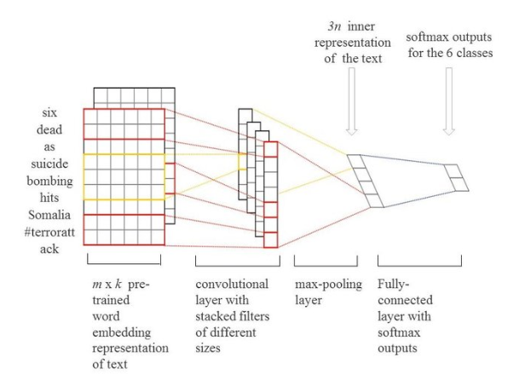
Algorithms
Convolutional neural network ( CNN )
ConveNet is a deeplearning model has special arcticture that detect object with dividing text to feature map instead of manual input using kernel input and parameter sharing that one parameter is enough to recognize hole image.
Accuracy: 0.8417999744415283

Slide 27
Algorithms
Feature extraction layers:
1)Input layer
2)Convolutional layer
3)Activation functions(relu)
4) Pooling
5)Bach layer
6)Dropout layer
7)Flatten layer
ConveNet phases : ConveNet contains nine layers

Slide 28
Algorithms
Then traditional neural network to do classificaton:
1)fully connected layer: connect neurons
Softmax : choose the highest probability output

Slide 29
Algorithms
Naive Bayes
The Naive Bayes algorithm is a probabilistic machine learning technique commonly used for classification tasks. Its benefits include:
1. Simplicity and Efficiency:
Naive Bayes is a simple and computationally efficient algorithm, making it easy to implement and well-suited for large datasets.
2. Fast Training and Prediction:
Due to its simplicity, Naive Bayes has fast training and prediction times, making it suitable for real-time applications.

Slide 30
Algorithms
Naive Bayes (Cont.)
3. Ease of Implementation:
It is straightforward to implement and requires minimal tuning of hyperparameters, making it an excellent choice for quick and effective solutions.
Accuracy: The resulting accuracy of using the naive bayes algorithm is 0.96950672

Slide 31
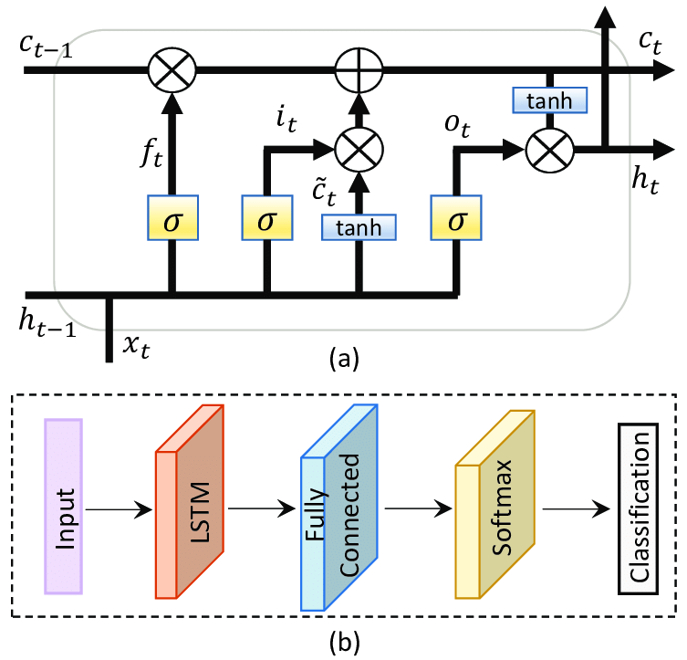
Algorithms
Algorithms:(Long Short – Term Memory):
LSTM (Long Short-Term Memory) algorithm is widely used in smooth and time-series data analysis.

Slide 32
Algorithms
Long Short – Term Memory (Cont.):
Here are some benefits of using LSTM algorithm:
1. Ability to deal with time:
LSTM has the ability to understand and analyze time series thanks to its ability to retain memory for long periods, which makes it useful in predicting future events in time series.
2. Dealing with the effect of short-term memory:
The design of LSTM allows it to bypass the problem of disappearing derivatives that occurs in ordinary neural networks when dealing with long time series.
Accuracy: The resulting accuracy of using the Lstm algorithm is 0.98654

Slide 33
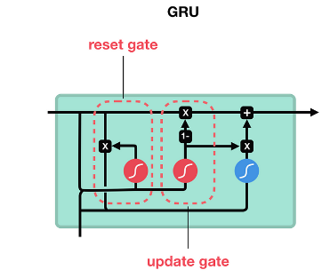
Algorithms
Gated recurrent unit GRU
Like LSTM, GRU can process sequential data such as text and time-series data. are used to control the flow of information the network.​
It uses only two gateways:
Update Gate: Decides how much new information will be added to the internal state.
Reset Gate: Determines the amount of reliance on previous information.​
Accuracy:The resulting accuracy of using the GRU algorithm is0.97223007

Slide 34
Algorithms
Random Forest
The random forest model is used to classify and predict data, and to deal with big data. It improves accuracy, making it a powerful tool in the field of machine learning and data analysis.​
Accuracy: 0.9650224215246637

Slide 35
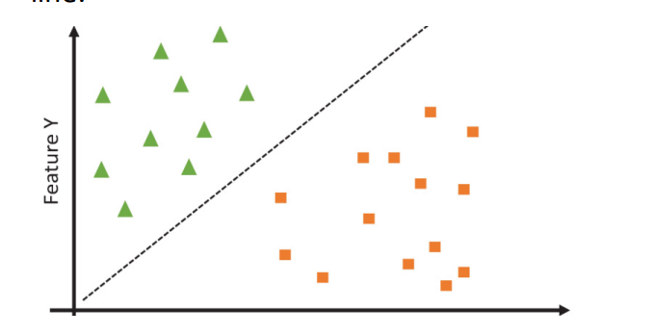
Algorithms
Support vector machine(SVM)
is one of supervised learning algorithms, which is used for classification problems in machine learning. The classification in email spam filter is binary classification. It works as a line that separates data and classifies it into ham emails and spam, with the top of the line being ham and the bottom being spam. This is done by converting data from text to numbers, then we normalized it. Data has been normalized enter the function (kernel ), so it determines its output, which based on it determines whether it is ham or spam and whether it is a direction of line.
The accuracy obtained using this model is :0.87224006

Slide 36
Comparison
This is the result of algorithms when it was 24 features
Algorithm | CNN | GRU | Random forest | Naïve bayes | LSTM | SVM
Accuracy | 0.841799 | 0.97223007 | 0.9650224 | 0.96950672 | 0 .98 | 0.87224006

Slide 37
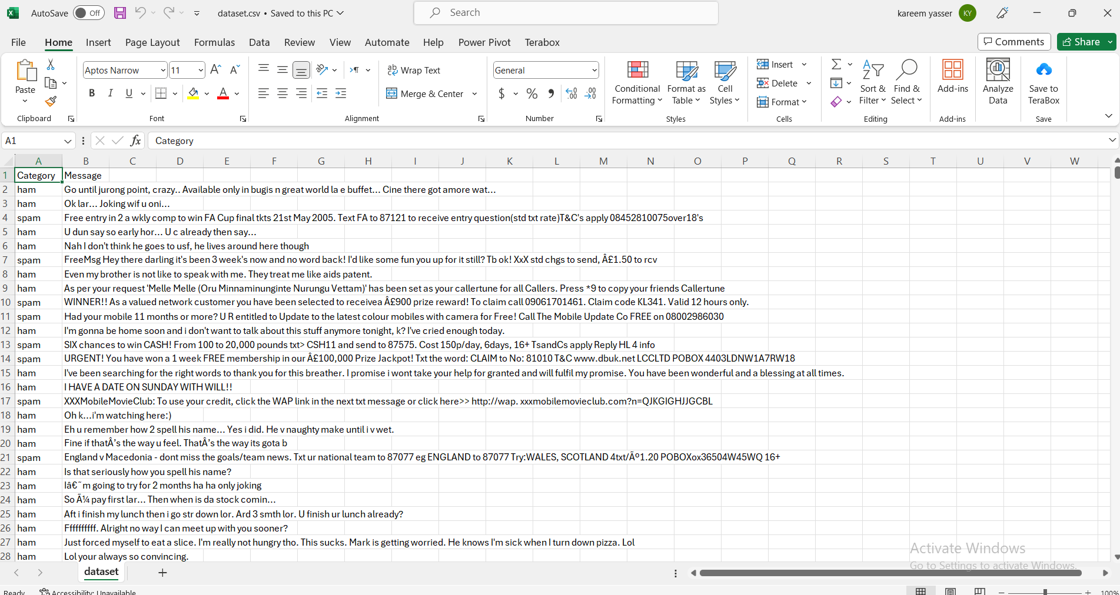
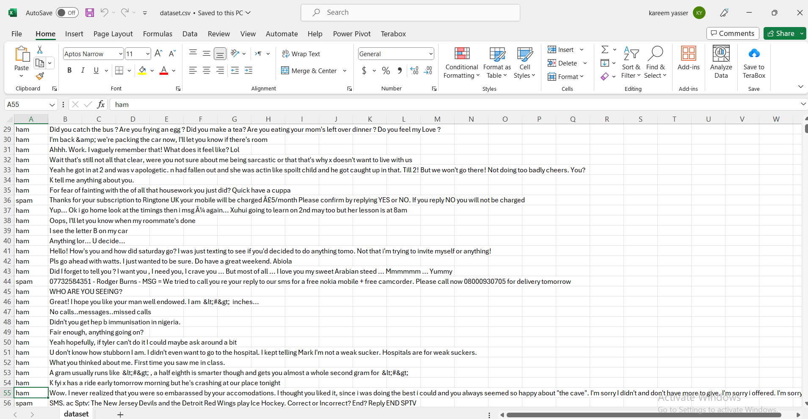
Data Set

Slide 38
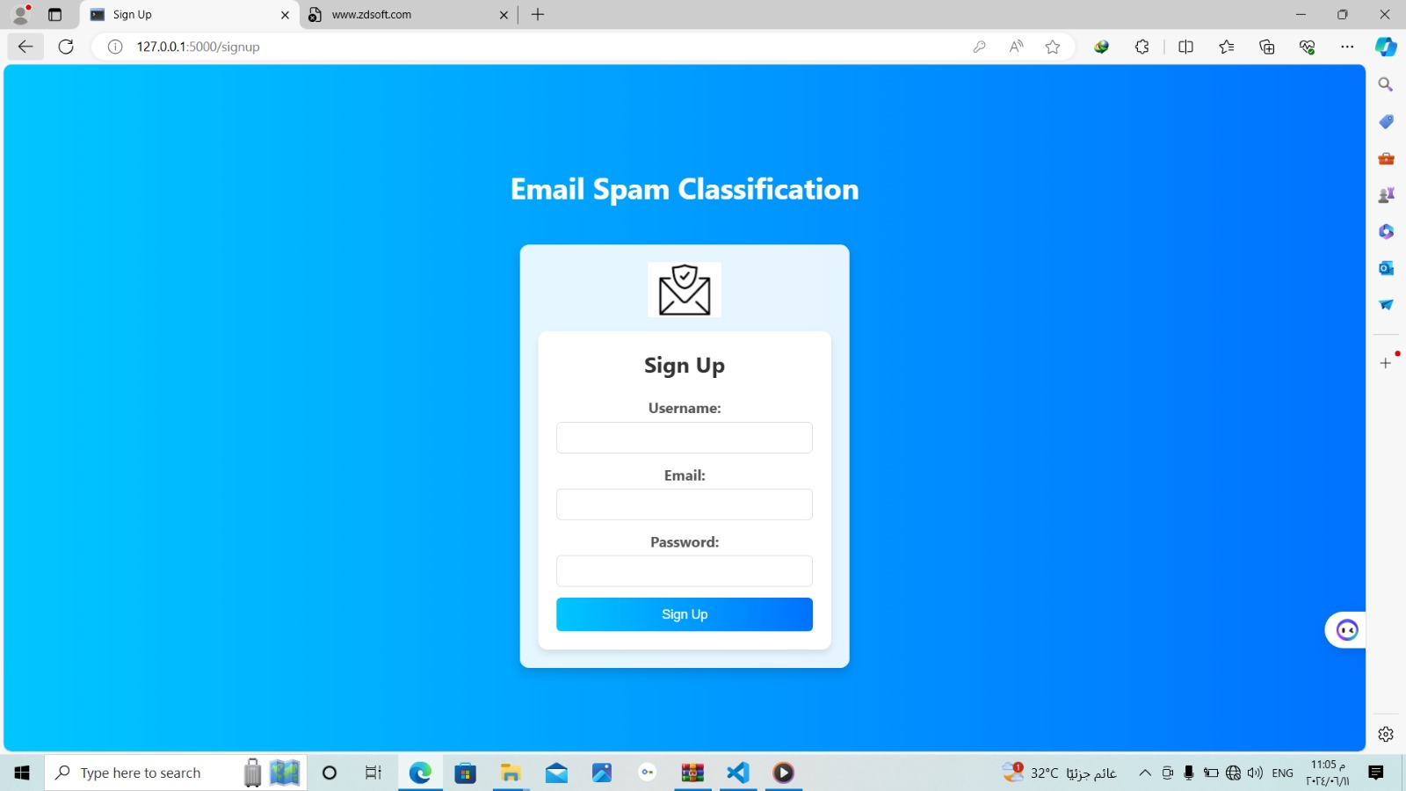
Overview of the web site
EELU laboratory to search for the best results for your analyzes with the utmost speed and accuracy.

Slide 39
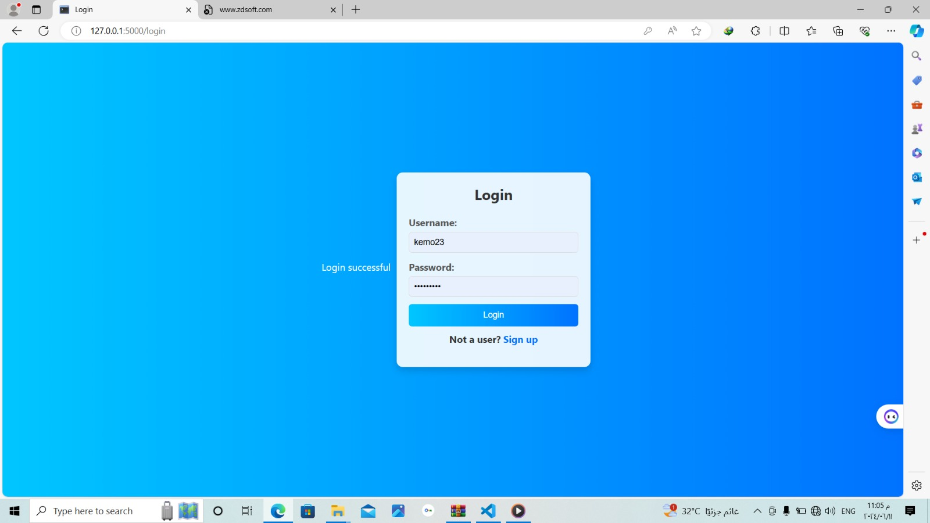

Slide 40
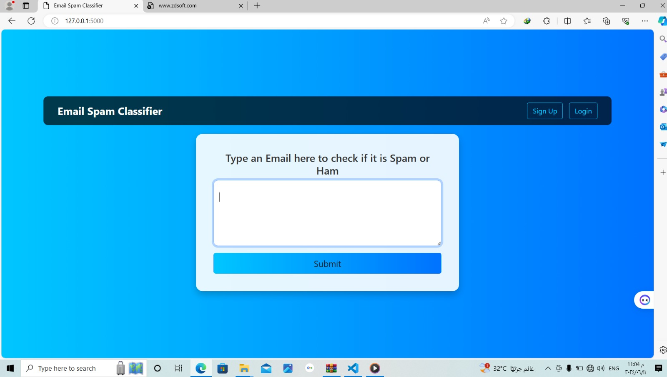

Slide 41
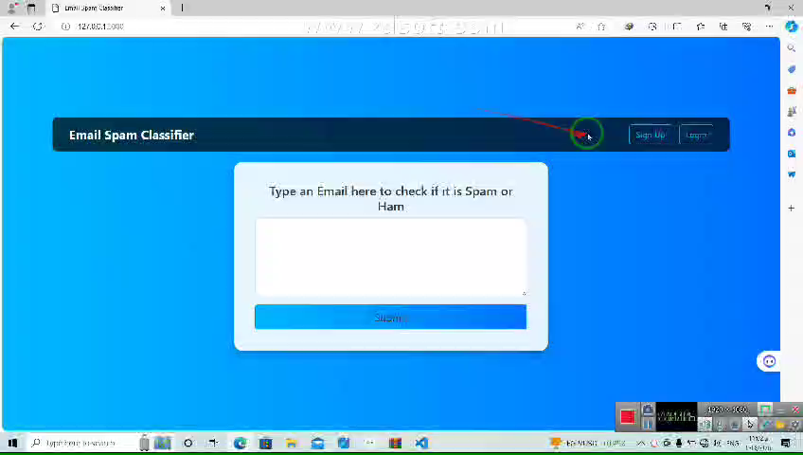

Slide 42
About this template
Tools and Technologies
Tools
1. Python. 6. Bootstrap
2. Colab, PyCharm
3. HTML
4. CSS
5.Flask
Machine learning
1. Support vector machine(SVM). 3. Random forest (RF).
2. Long-Short Term memory(Lstm). 4. Gated Recurrent Unit (GRU)
5. Naïve Bayes 6. Convolutional neural networks (CNN)

Slide 43
About this template
Future Work
For future work on an email spam filter project, you can consider a variety of enhancements and expansions to improve the model's performance, adaptability, and robustness. Here are several directions you might take:
1. Model Improvements
Advanced Machine Learning Models: Experiment with more sophisticated models such as Gradient Boosting Machines Support Vector Machines, and deep learning models like Recurrent Neural Networks (RNNs) and Convolutional Neural Networks (CNNs).
Ensemble Methods: Combine multiple models to create an ensemble that leverages the strengths of different algorithms to improve accuracy and robustness.

Slide 44
Future Work
Feature Engineering
Advanced Text Representations: Implement advanced text representation techniques like Word2Vec, GloVe, or BERT to capture more contextual information from the emails.
Metadata Features: Incorporate additional features such as email metadata (e.g., sender domain, email client used, time of day) to provide more context.
Content Analysis: Analyze the structure and format of emails, including attachments, embedded images, and links, to identify spam patterns that are not apparent from text alone.

Slide 45
Future Work
Handling Imbalanced Data
Resampling Techniques: Use techniques such as SMOTE (Synthetic Minority Over-sampling Technique) or ADASYN (Adaptive Synthetic Sampling) to handle class imbalance.
Cost-Sensitive Learning: Implement cost-sensitive learning algorithms that assign higher penalties to misclassifying the minority class (spam).
Real-Time Filtering
Streaming Data Processing: Develop a system capable of processing emails in real-time using streaming data frameworks like Apache Kafka or Apache Flink.
Low Latency Models: Optimize models for low-latency predictions to ensure real-time spam detection without delaying email delivery.

Slide 46
Future Work
Model Interpretability and Explainability
Interpretability Tools: Use tools like LIME (Local Interpretable Model-agnostic Explanations) or SHAP (SHapley Additive exPlanations) to explain model predictions, which can help in understanding why an email is classified as spam.
User Feedback Loop: Implement a feedback mechanism where users can report false positives and false negatives, and use this feedback to continually improve the model.
Robustness and Security
Adversarial Training: Train models to be robust against adversarial attacks where spammers intentionally manipulate content to evade detection.
Regular Updates: Regularly update the model with new spam patterns and trends to keep up with evolving spam tactics.

Slide 47
About this template
Conclusion
The goal of our web application is to develop a system capable of identifying spam messages and separating them from legitimate ones. This system aims to improve the user experience, increase security, and reduce the time and effort required to manage email.
However, we tried to use the machine learning technique with the highest accuracy among other techniques.
We have also done our best to make it as easy as possible for any user to use it correctly and in the most effective way possible.

Slide 48
About this template
Reference (1)
1. A Comprehensive Survey for Intelligent Spam Email Detection
https://ieeexplore.ieee.org/document/8907831
2. Email Spam Detection using Deep Learning Approach
https://ieeexplore.ieee.org/document/9850588
3. Advanced Email Spam Detection: A Machine Learning Solution
https://ieeexplore.ieee.org/document/10393777

Slide 49
About this template
Reference (2)
4. Email Spam Filtering: A Systematic Review
https://ieeexplore.ieee.org/document/8187090
5. An Intelligent Model of Email Spam Classification
https://ieeexplore.ieee.org/document/10059620

Slide 50
Thank You!

